Slide 1
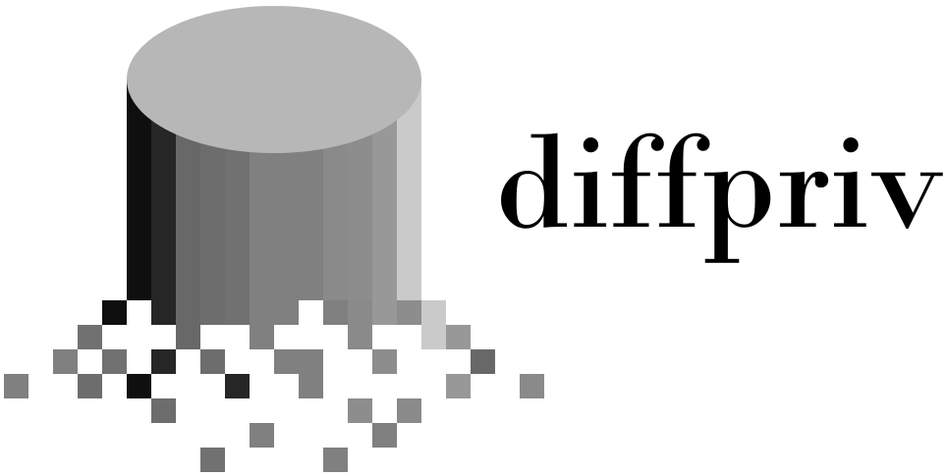

Provably-private learning in R
https://brubinstein.github.io/diffpriv/

